Slide 1


Optimizing Agricultural Resource Allocation through Reinforcement Learning: A Cost-Driven Approach to Crop Efficiency Enhancement
Dr. Zuhair Zafar
Dr. Muhammad Moazam Fraz
Dr. Fahad Ahmed Satti
Dr. Syed Imran Ali
Haider Masood
401636
MS-AI 2k22
28th OCTOBER 2025

Slide 2
PRESENTATION OUTLINE
Introduction
Motivation
Literature Review
Research Gaps
Problem Statement
Solution Statement
Research Objectives
Approach / Methodology
Proposed Timeline

Slide 3
INTRODUCTION

Slide 4
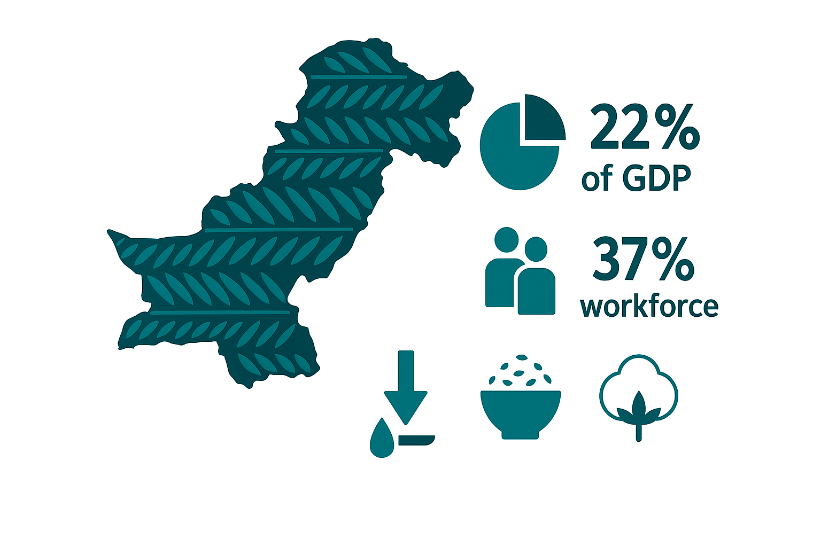
INTRODUCTION
PAKISTAN AN AGRICULTURAL NATION
~22% of GDP.
Major irrigated area
Exports share (rice, cotton)
Employs 36.1% of labor force
https://www.agripunjab.gov.pk https://tradingeconomics.com/pakistan/employment-in-agriculture-percent-of-total-employment-wb-data.html

Slide 5
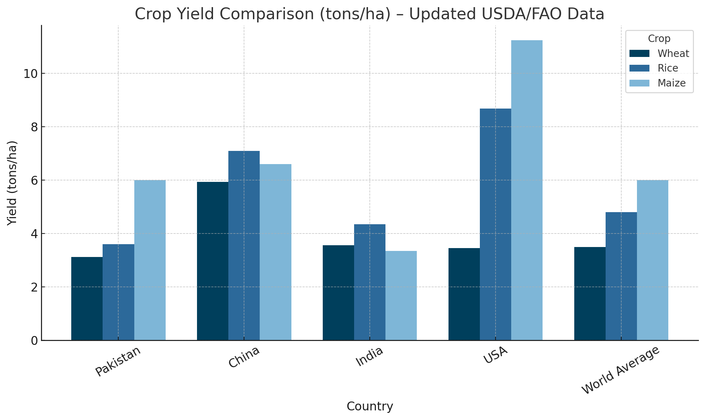
INTRODUCTION
Global Agricultural Production Comparison
Pakistan's Agricultural Performance vs. Global Standards
Country | Wheat Yield (tons/ha) | Rice Yield (tons/ha) | Maize Yield (tons/ha)
Pakistan | 2.8 | 3.6 | 4.9
China | 5.4 | 7 | 6.3
India | 3.5 | 4 | 3.2
USA | 3.2 | 8.7 | 11.1
World Average | 3.4 | 4.6 | 5.9
https://ipad.fas.usda.gov/countrysummary/Default.aspx?id=PK&crop=Wheat

Slide 6
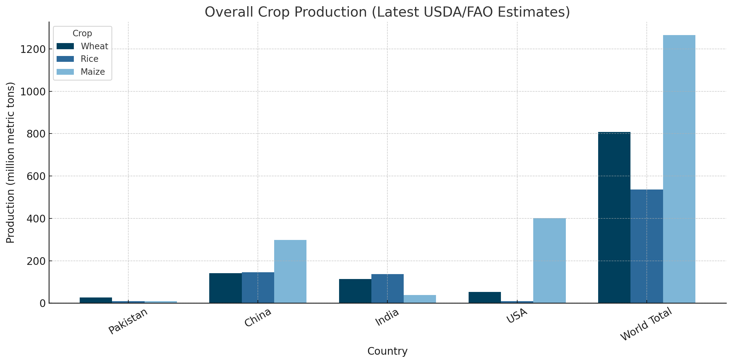
INTRODUCTION
Global Agricultural Production Comparison
Pakistan's Agricultural Performance vs. Global Standards
Country | Wheat | Rice (milled-eq.) | Maize
Pakistan | 27.5 MMT | 9.8 MMT | 9.6 MMT
China | 141 MMT | 146 MMT | 298 MMT
India | 113.3 MMT | 137.8 MMT | 37.7 MMT
United States | ≈52 MMT (1.921 bn bu) (downloads.usda.library.cornell.edu) | ≈10 MMT (222 M cwt) (lsuagcenter.com) | ≈402 MMT (15.82 bn bu) (feedandgrain.com)
World total | 808.5 MMT (graincentral.com) | 535.8 MMT (ers.usda.gov) | 1 265 MMT (usda.gov)
https://ipad.fas.usda.gov/countrysummary/Default.aspx?id=PK&crop=Wheat

Slide 7
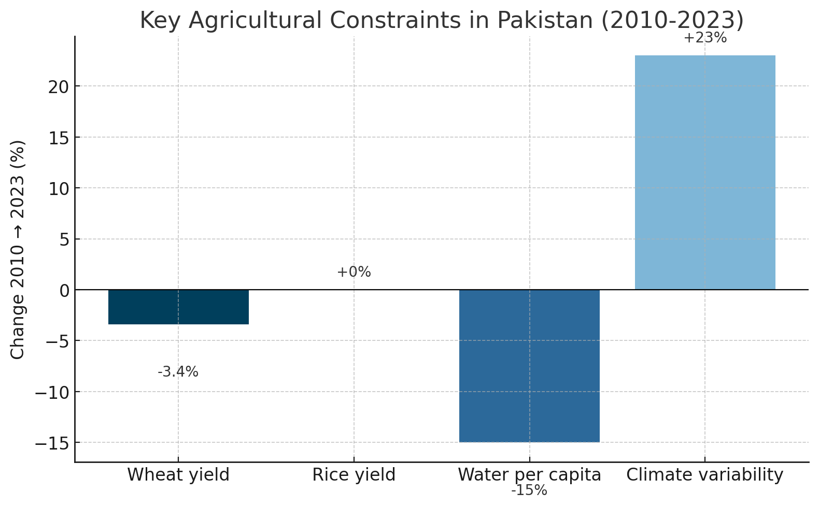
INTRODUCTION
Productivity Headwinds (2010-2023)
Key facts:
Wheat yield ↓ 3 % (2.9 → 2.8 t ha⁻¹)
Rice yield flat (≈ 3.6 t ha⁻¹)
Per-capita water ↓ 15 %
Climate-variability index ↑ 23 %
Reasons:
Inefficient fertilizer timing
Flood-irrigation losses > 40 %
Low adoption of precision tech
More heatwaves, floods, droughts
USDA Production Database 2024; FAO AQUASTAT 2023; Pakistan Met Dept. extreme-weather index 2024.

Slide 8
MOTIVATION

Slide 9
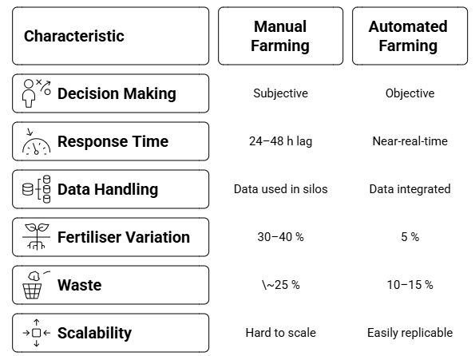
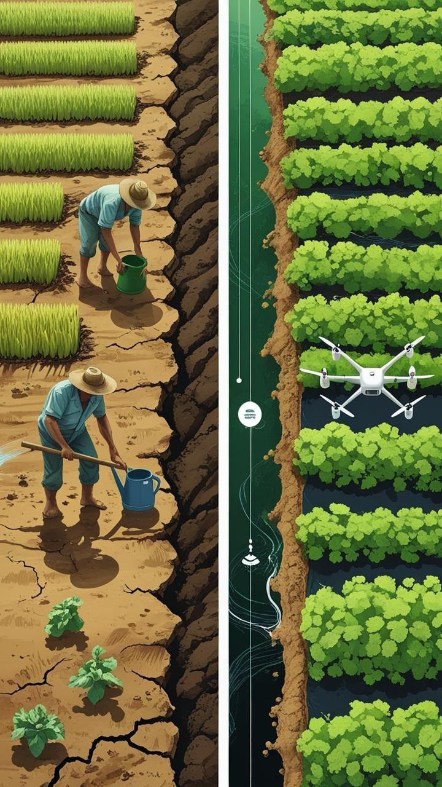
MOTIVATION
Comparison of Manual Farming Practice with Automated or Smart Farming Practice

Slide 10
LITERATURE REVIEW

Slide 11
LITERATURE REVIEW
Machine Learning Approaches in agriculture and their limitations
Paper Title | Authors | Strengths | Weaknesses | Dataset Used | Venue & Year
Integrating Random Forest & Crop Modeling Improves Yield of Winter Wheat & Oilseed Rape [1] | Dhillon et al. | Hybrid RF + LUE model lifts R² & cuts RMSE vs. RF w/o crop‑model inputs. Uses NDVI + climate ↔ crop growth priors. | Tested in one European region; transferability unknown. Needs crop‑model calibration. | Sentinel‑2 NDVI, ERA5 climate; field yields (Germany) | Frontiers in Remote Sensing, 2022
CLIMATES: Mitigating Low Productivity on African Smallholder Farms [2] | Tabar et al. | Clustering + per‑cluster ensemble lowers error vs. LSTM/VRNN. Handles 2.2 k farm time‑series with diverse climates. | Relies on quality cluster labels. Designed for environmental stress forecasting, not prescriptions. | Environmental time‑series (AET, RET, NPP) from 2 200 African farms | AAAI 2022

Slide 12
LITERATURE REVIEW
Machine Learning Approaches in agriculture and their limitations
Paper Title | Authors | Strengths | Weaknesses | Dataset Used | Venue & Year
Optimal Greenhouse Sensor Placement via GBM Grid‑Search [3] | Uyeh et al. | Gradient Boosting selects minimal sensors with lowest RMSE. Psychrometric feature engineering improves predictions. | Focus on temperature/ humidity only. Validation limited to two greenhouses. | IoT sensor readings (T, RH) in protected cultivation | Frontiers in Plant Science, 2022
Explainable Crop Recommendation with Ensemble ML [4] | Shastri et al. | Compares 10 algorithms; Gradient Boosting highest accuracy. LIME explains nutrient/weather influence on crop choice. | Static recommendation (no temporal dynamics). Tested on Indian soils only. | Soil N‑P‑K & weather data (India) | Scientific Reports, 2025

Slide 13
LITERATURE REVIEW
Deep Learning Approaches in agriculture and their limitations
Paper Title | Authors | Strengths | Weaknesses | Dataset Used | Venue & Year
CropAndWeed Dataset: Multi‑Modal Learning for Precision Weeding [5] | Steininger et al. | 8 k aerial RGB images → 112 k instances. CNN detector benefits from species diversity; supports detection + segmentation. | Drone imagery only; ground‑level viewpoint not tested. | CropAndWeed (74 species, images + meta) | WACV 2023
iGrow: Autonomous Greenhouse Control with Deep RL [6] | Cao et al. | Neural “digital twin” + deep RL → +10.2 % tomato yield, +92.7 % profit vs. experts. | Domain‑specific simulator requires calibration per greenhouse. RL generalisation across climates untested. | Real tomato greenhouse sensor/control logs | AAAI 2022

Slide 14
LITERATURE REVIEW
Deep Learning Approaches in agriculture and their limitations
Paper Title | Authors | Strengths | Weaknesses | Dataset Used | Venue & Year
Deep Diagnosis: Real‑time Apple Leaf Disease Detection [8] | Khan et al. | Lightweight CNN runs in real‑time on edge devices; high accuracy on multiple apple diseases. | Apple‑specific; cross‑crop transferability untested. | Custom apple leaf image set (lab + orchard) | Computers & Electronics in Agriculture, 2022
Augmentation Invariance & Adaptive Sampling for Aerial Segmentation [9] | Tavera et al. | Consistency loss + adaptive sampling ↑ mIoU on Agriculture‑Vision. Robust to rotations/lighting changes. | Benefits diminish on ground imagery. Adds training complexity. | Agriculture‑Vision (aerial RGB‑NIR) | CVPR Workshops 2022
Utilizing Vision‑Language Models for Detection of Leaf‑Based Diseases in Tomatoes [10] | James B. Eleojo | Leverages a pre‑trained vision‑language model → strong few‑shot generalisation Achieved F1 ≈ 0.94 on field‑captured leaves | Compute‑heavy (VLM fine‑tuning) Trained on tomato only → limited crop transferability | 12 k labelled tomato‑leaf images (greenhouse + field) | AAAI 2025 (AI for Social Impact)

Slide 15
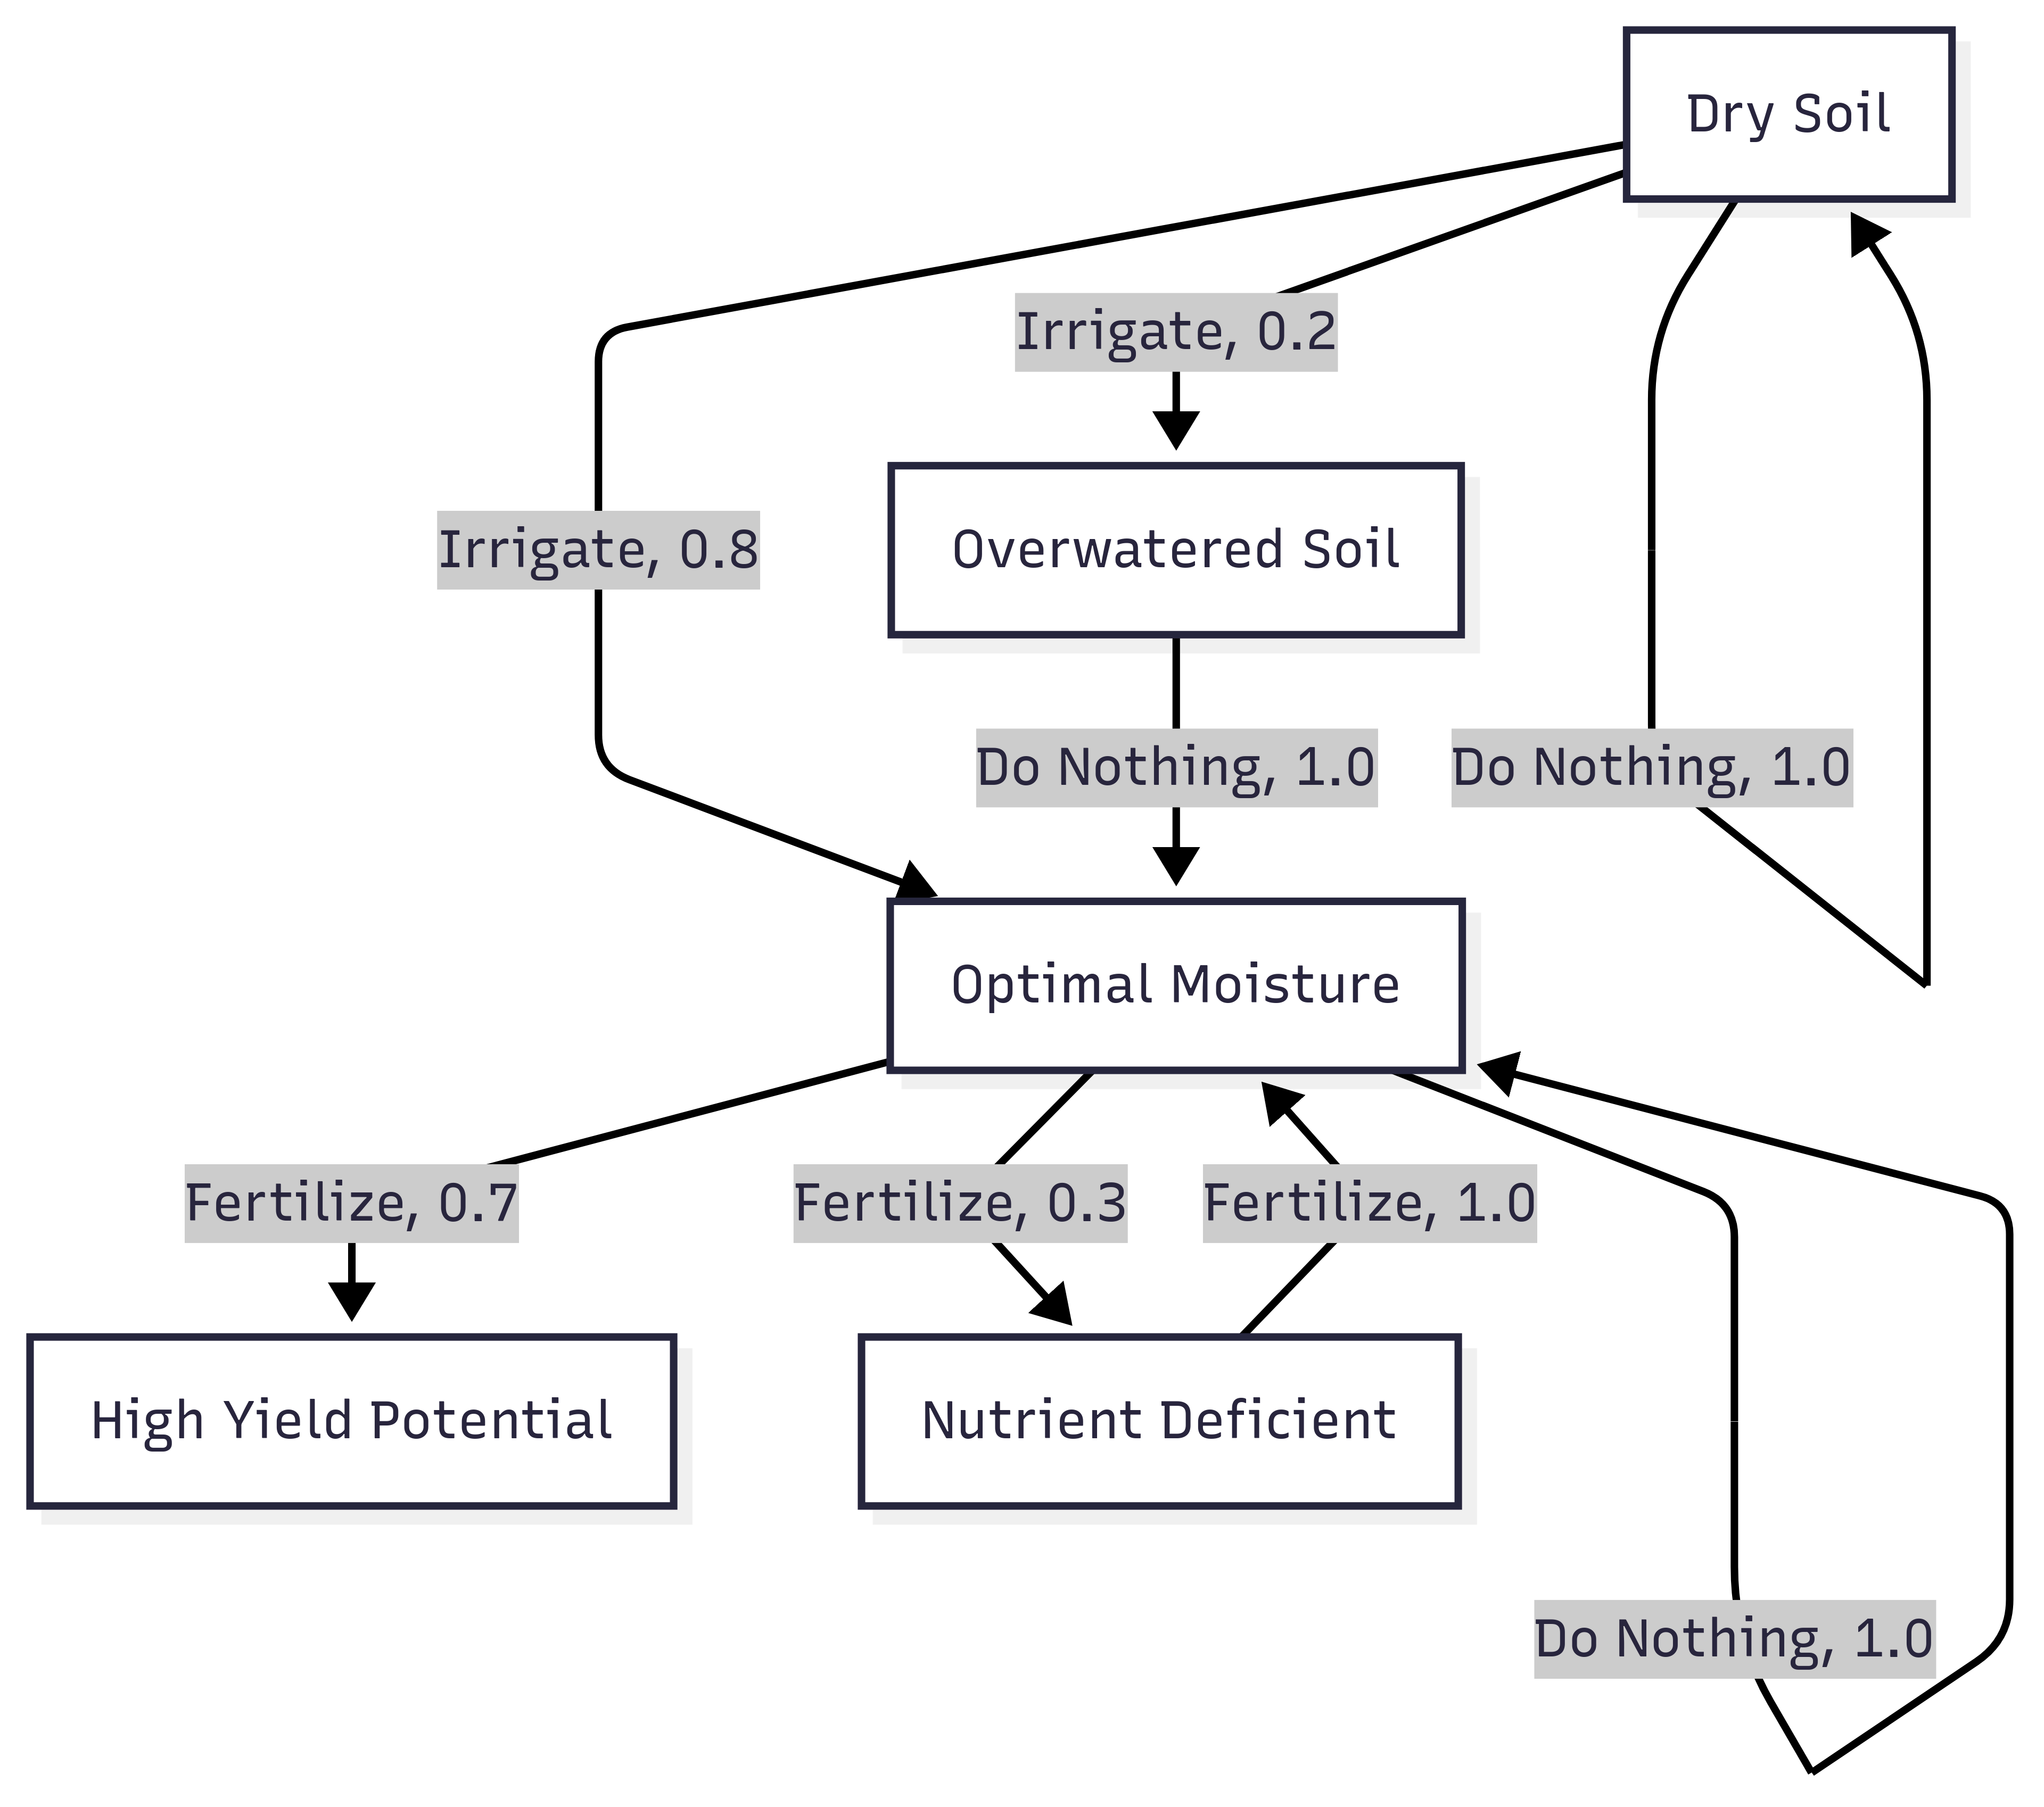
LITERATURE REVIEW
Why Reinforcement Learning for Agriculture ?
Interactive learning – agent explores crop/soil climate environment through trial-and-error and continuously improves its policy
Sequential decision-making (MDP) – models season-long input choices as a Markov Decision Process to maximize long-term reward (yield − cost)
Real-time adaptation – dynamically adjusts fertilizer, irrigation, and sowing under weather and pest uncertainty using feedback

Slide 16
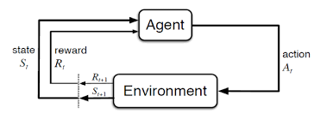
LITERATURE REVIEW
Why Reinforcement Learning for Agriculture ?
Reinforcement learning loop:
The agent interacts with the environment, receiving observations and rewards.
AN AGENT (think of it as an AI farmer) observes the environment (the farm simulation) and decides on an action (e.g. how much to irrigate or fertilize).
The ENVIRONMENT then updates the crop growth and returns a reward (a score) and a new state back to the agent.
This LOOP REPEATS OVER TIME, and the agent’s goal is to learn a policy that maximizes the cumulative reward (for example, high crop yield minus input costs)

Slide 17
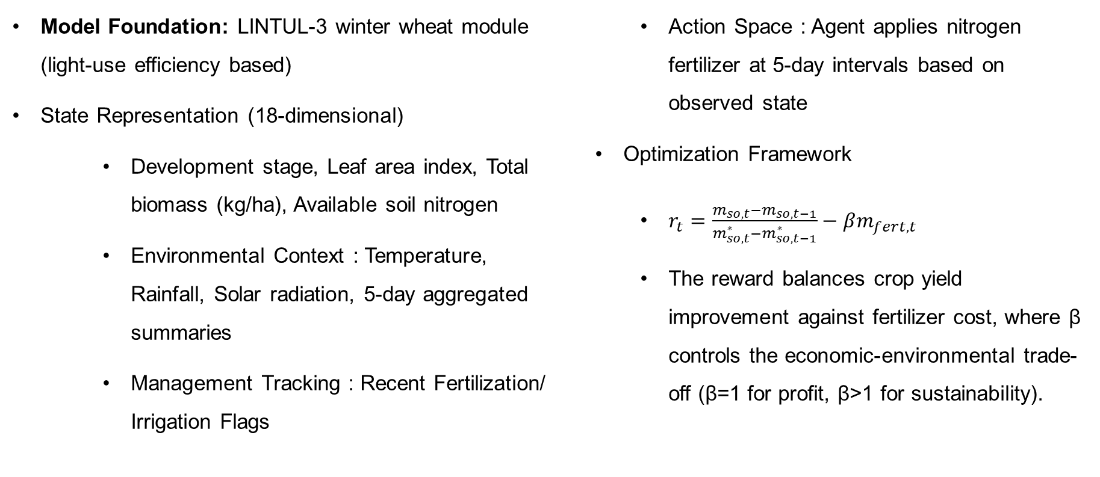
LITERATURE REVIEW
RL PAPER 1 : CropGym: a Reinforcement Learning Environment for Crop Management (Environmental Data Science by Cambridge University Press)
Model Foundation: LINTUL-3 winter wheat module (light-use efficiency based)
State Representation (18-dimensional)
Development stage, Leaf area index, Total biomass (kg/ha), Available soil nitrogen
Environmental Context : Temperature, Rainfall, Solar radiation, 5-day aggregated summaries
Management Tracking : Recent Fertilization/ Irrigation Flags
Action Space : Agent applies nitrogen fertilizer at 5-day intervals based on observed state
Optimization Framework
$r_{t}=\frac{m_{so,t}−m_{so,t−1}}{m_{so,t}^{∗}−m_{so,t−1}^{∗}}−βm_{fert,t}$
The reward balances crop yield improvement against fertilizer cost, where β controls the economic-environmental trade-off (β=1 for profit, β>1 for sustainability).

Slide 18
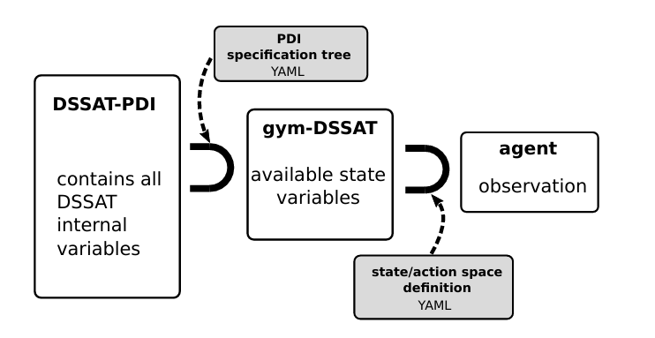
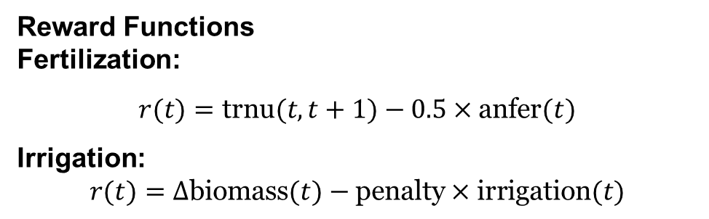
LITERATURE REVIEW
RL PAPER 2 : Gym-DSSAT: a crop model turned into a Reinforcement Learning environment (Research Report N° 9460 by Inria)
Crop Model: DSSAT (Decision Support System for Agrotechnology Transfer)
Implementation: Fortran-Python coupling via PDI
Crops: Maize (extensible to 41+ crops)
Episode: Full growing season (~160 days) Decisions: Daily time steps Weather: WGEN stochastic generator Termination: Crop maturity or early failure
State Space (13 variables)
Growth stages, biomass, nitrogen stress, leaf area, weather, cumulative inputs
Reward Functions
Fertilization:
$$r(t)=\text{trnu}(t,t+1)−0.5×\text{anfer}(t)$$
Irrigation:
$$r(t)=Δ\text{biomass}(t)−\text{penalty}×\text{irrigation}(t)$$

Slide 19

LITERATURE REVIEW
Why Long-Term Planning in Agriculture Needs AI
Modern agriculture faces a multi-objective challenge:
Maximize profit while minimizing environmental harm and adapting to weather variability and soil degradation.
Farmers often make single-season decisions, but in reality, agriculture is interdependent across years:
Fertilizer applied this year affects soil nitrogen next year
Crop choices affect pests, diseases, and water balance
Unplanned fertilizer use causes waste and pollution
What is Leaching?
When too much nitrogen fertilizer is applied, the excess leaches — it dissolves in rainwater and moves beyond the root zone

Slide 20
LITERATURE REVIEW
RL PAPER 3 : Long-Term Crop Management Strategies with CyclesGym (NeurIPS 2022)
 | Year 1 |  | Year 2 |  | Reduced Leaching | Reduced Emissions | Profit
Environment | 🌧️ |  | ☀️
Management Strategies | Maize | Fertilization | Maize | Fertilization | ❌ | ❌ | ✔️
 | Soy |  | Soy |  | ✔️ | ✔️ | ❌
 | Soy |  | Maize | Low Fertilization | ✔️ | ✔️ | ✔️
Strategy | Profit | Environmental impact | Why / mechanism
Monoculture maize + non-organic fertilization | High ↑ | High ↑ | Heavy fertilizer → big yields, but N leaching + GHG emissions rise
Soybean focus with low fertilization | Lower ↓ | Low ↓ | Lower yields from soy; minimal external N input
Maize–soybean rotation, leverages soy N-fixation | High ↑ | Medium–Low ↘ | Soy adds N biologically → less fertilizer for maize, decent yields

Slide 21
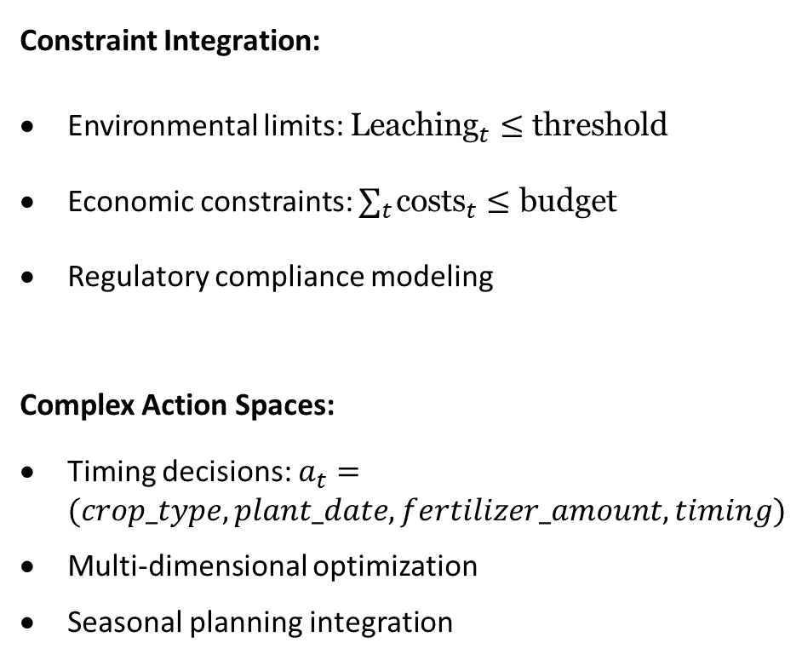
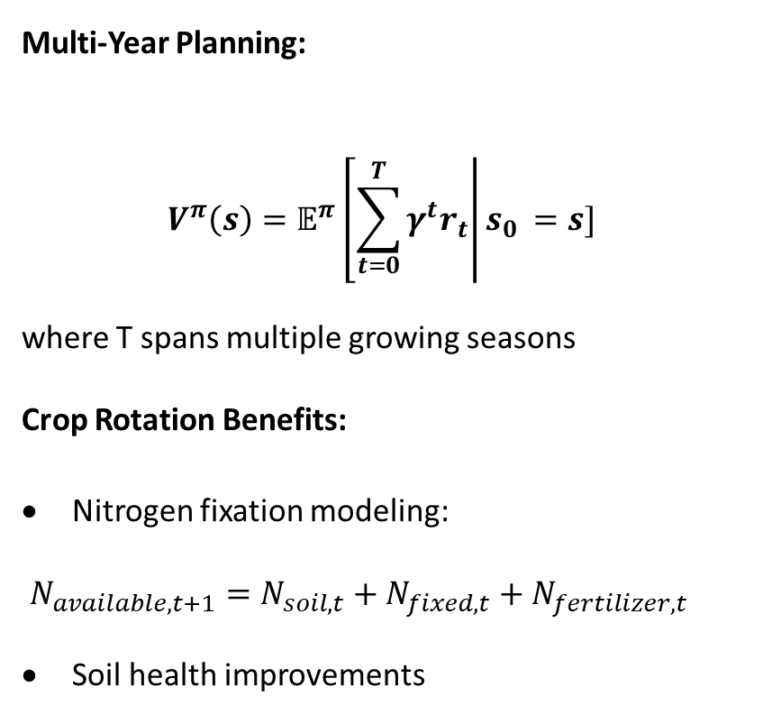
LITERATURE REVIEW
RL PAPER 3 : Long-Term Crop Management Strategies with CyclesGym (NeurIPS 2022)
Multi-Year Planning:
$$V^{π}\left(s\right)=𝔼^{π}\left[\sum_{t=0}^{T}{γ^{t}r_{t}}\right|s_{0 }=s]$$
where T spans multiple growing seasons
Crop Rotation Benefits:
Nitrogen fixation modeling:
$N_{available,t+1}=N_{soil,t}+N_{fixed,t}+N_{fertilizer,t}$
Soil health improvements
Constraint Integration:
Environmental limits: ${\text{Leaching}}_{t}≤\text{threshold}$
Economic constraints: $∑_{t} {\text{costs}}_{t}≤\text{budget}$
Regulatory compliance modeling
Complex Action Spaces:
Timing decisions: $a_{t}=(crop_type,plant_date,fertilizer_amount,timing)$
Multi-dimensional optimization
Seasonal planning integration

Slide 22
RESEARCH GAP

Slide 23
RESEARCH GAP
Regional Agricultural Challenges
Reinforcement Learning Based Approaches in Pakistan
RL has been applied in greenhouse environments or precision farming in developed countries, but there is almost no work in open-field, smallholder contexts in South Asia.
Absence of Multi-Objective Optimization:
Existing models often optimize only yield or revenue, not long-term soil health, water sustainability, or resilience to climate variability.
Climate Adaptation:
No adaptation to shifting climate patterns
No Integration with Local Economic Constraints:
Most existing models do not account for smallholder farm sizes, limited capital, and fluctuating input prices common in Pakistan.
Data-to-Decision Gap:
Research largely remains in academic papers without being translated into tools for local farmers or policymakers.

Slide 24
PROBLEM STATEMENT

Slide 25
PROBLEM STATEMENT
“ Existing reinforcement learning-based agricultural management systems are developed for North American and European contexts and cannot be directly applied to Pakistani agricultural conditions due to different climate patterns, crop varieties, farming practices, and economic constraints ”

Slide 26
SOLUTION STATEMENT

Slide 27
SOLUTION STATEMENT
Proposed Solution: Pakistan-Adapted Agricultural RL Framework
Core Solution: Develop a comprehensive reinforcement learning framework based on CyclesGym architecture, adapted for Pakistani agricultural context with integrated climate modeling, local crop varieties, and economic constraints.
Key Components:
Climate Module: Monsoon pattern integration and drought modeling
Crop Adaptation: Pakistani wheat, rice, cotton, and maize varieties
Soil Data: Local soil data

Slide 28
RESEARCH OBJECTIVES

Slide 29
RESEARCH OBJECTIVES
Develop a CyclesGym-PK simulation environment
Inject monsoon weather series, Indus-plain soil profiles and local wheat/rice cultivars
Design a cost-aware reward function
Maximise net profit while penalising water use and N-leaching
Train a PPO agent for weekly irrigation scheduling
Learn policies under stochastic monsoon rainfall data

Slide 30
RESEARCH METHODOLOGY

Slide 31
RESEARCH METHODOLOGY
Methodology Overview
Data stream | Source & format
Weather | Pakistan Meteorological Dept. → .weather
Soil profile | FAO Indus‑loam → .soil
Crop cultivar | IRRI‑6 rice, Sehar‑06 wheat → GenericCrops.crop
Price & cost constants | Pakistan Bureau of Statistics market bulletins → reward_config.json
Weather generator: PKWeatherGenerator(csv_dir, delta_days=7)
Soil generator: StaticSoilGenerator("IndusLoam.soil")
Rotation file: rice → wheat 2‑year .operation template (monsoon sow 10 Jul; rabi sow 15 Nov)
Delta & horizon: delta_days=7, duration_years=2
Baseline check: Simulator reproduces ≈ 3.6 t ha⁻¹ rice & 2.8 t ha⁻¹ wheat with farmer schedule

Slide 32
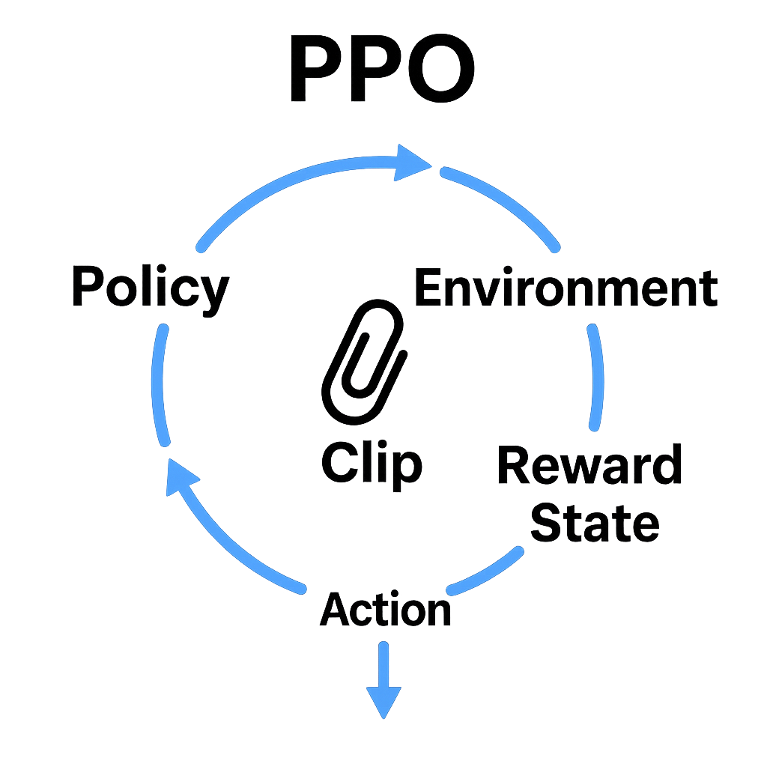
RESEARCH METHODOLOGY
PPO Agent Setup
Setting | Value | Rationale
NN | 2 × 64 dense (Tanh) | Standard PPO baseline
Actions | irrigation ∈ {0, 25, 50 mm week⁻¹} | Keeps search space small
Batch | 16 environments × 128 steps | ≈ 2 500 wk batch ≈ 5 CPU‑min
Hyper‑params | γ: 0.99 Clip: 0.2 Learning Rate: 3e‑4 Entropy: 0.01 | Default stable config
Training budget | 100 k episodes (≈ 8 CPU‑hrs)

Slide 33
RESEARCH METHODOLOGY
Reward Shaping Matters
Reward shaping is not just tuning numbers it's defining the problem itself.
Why it's essential in CyclesGym:
Pakistani agriculture has unique economics (crop prices, water costs, fertilizer subsidies).
Environmental penalties (e.g. nitrate limits) are region-specific and policy-relevant.
Without proper shaping, the agent may learn:
Costly over-irrigation,
Excess fertilization (high leaching),
Or exploit unrealistic dynamics.
Why Reward Shaping is Non-Trivial:
Even small changes (e.g., soil type, cultivar) alter how actions impact future rewards → it becomes a new MDP, not just a new dataset.
RL agents must re-learn the effect of each action in this changed world transferring old policies fails.
Penalty weights (𝛽) require careful tuning to balance economics vs. sustainability.
It encodes local reality into the simulator and ensures the RL agent’s learned behavior is aligned with real-world goals.

Slide 34
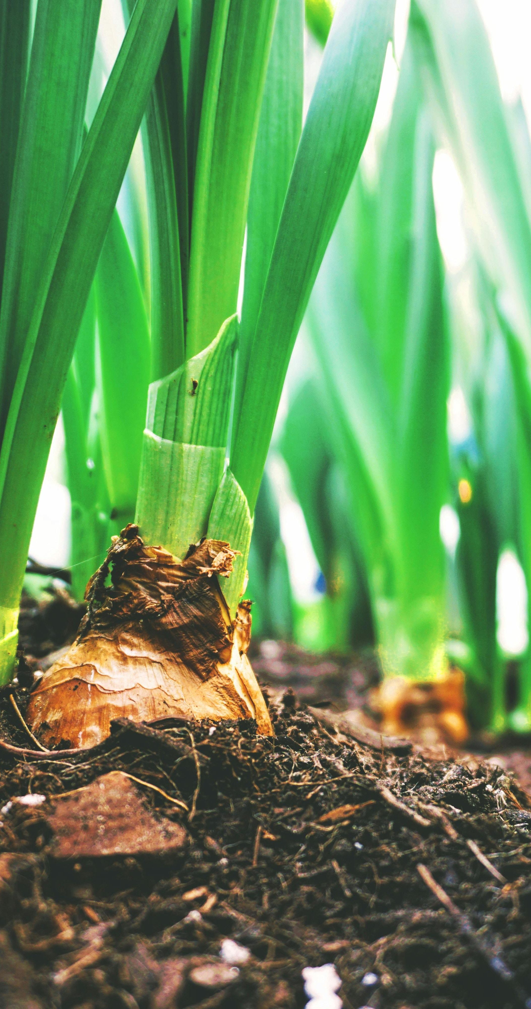
RESEARCH METHODOLOGY
Evaluation & Robustness Plan
Weather sets: dry (2019), median (2020), wet (2022)
Soil PAW ±10 %: test shallow vs. deep loam
Price shock: urea + 15 %, rice price – 10 %
KPIs
Yield (t ha⁻¹)
Irrigation (mm)
Net profit (PKR ha⁻¹) – computed by reward class
N‑use efficiency (%)
Constraint breaches (N‑leach > 40 kg ha⁻¹ yr⁻¹)

Slide 35
TIMELINE

Slide 36
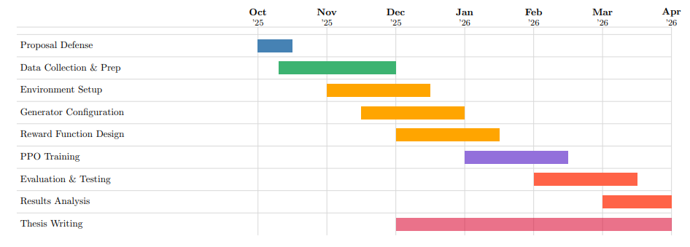
Timeline
October 2025 – April 2026

Slide 37
CONCLUSION

Slide 38
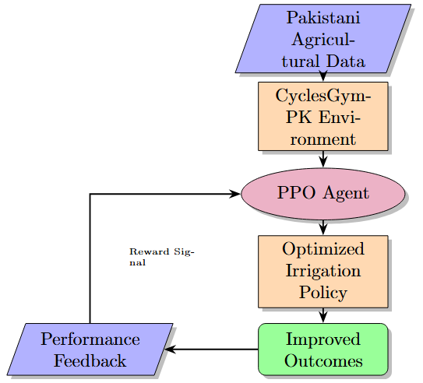
Conclusion
Key Contributions:
First RL-based agricultural framework adapted for Pakistani context
Integration of local climate patterns, soil data, and economic constraints
Cost-aware reward function balancing profit and sustainability
Practical irrigation scheduling tool for smallholder farms
Expected Impact:
Reduced nitrogen leaching and environmental footprint
Data-driven decision support for farmers
Extensible framework for other South Asian regions
Future Directions:
Multi-crop rotation optimization
Real-world pilot deployment with farmers
Integration with IoT sensors and mobile platforms

Slide 39
REFERENCES
[1] Dhillon, M. S., T. Dahms, C. Kuebert-Flock, T. Rummler, J. Arnault, I. Steffan-Dewenter, and T. Ullmann. “Integrating random forest and crop modeling improves the crop yield prediction of winter wheat and oil seed rape.” Frontiers in Remote Sensing, vol. 3, 2023 (published Jan 2023).
[2] Tabar, M., D. Lee, D. P. Hughes, and A. Yadav. “Mitigating Low Agricultural Productivity of Smallholder Farms in Africa: Time-Series Forecasting for Environmental Stressors.” Proceedings of the 36th AAAI Conference on Artificial Intelligence (AAAI-22), 2022.
[3] Uyeh, D. D., O. Iyiola, R. Mallipeddi, S. A. Hiablie, M. Amaizu, Y. Ha, and T. Park. “Grid Search for Lowest Root Mean Squared Error in Predicting Optimal Sensor Location in Protected Cultivation Systems.” Frontiers in Plant Science, vol. 13, 2022.
[4] Shastri, S., S. Kumar, V. Mansotra, et al. “Advancing crop recommendation system with supervised machine learning and explainable artificial intelligence.” Scientific Reports, vol. 15, Article 25498, 2025.
[5] Steininger, D., A. Trondl, G. Croonen, J. Simon, and V. Widhalm. “The CropAndWeed Dataset: A Multi-Modal Learning Approach for Efficient Crop and Weed Manipulation.” Proceedings of IEEE/CVF WACV, pp. 3729–3738, 2023.

Slide 40
REFERENCES
[6] Cao, X., Y. Yao, L. Li, W. Zhang, Z. An, Z. Zhang, L. Xiao, et al. “iGrow: A Smart Agriculture Solution to Autonomous Greenhouse Control.” Proceedings of AAAI 36(11), pp. 11837–11845, 2022.
[7] Wu, J., D. Pichler, D. Marley, N. Hovakimyan, and D. A. Wilson. “Extended Agriculture-Vision: An Extension of a Large Aerial Image Dataset for Agricultural Pattern Analysis.” Transactions on Machine Learning Research (TMLR), published Apr 2023.
[8] Khan, A. I., S. M. K. Quadri, S. Banday, and J. L. Shah. “Deep diagnosis: A real-time apple leaf disease detection system based on deep learning.” Computers and Electronics in Agriculture, vol. 199, Article 107093, 2022.
[9] Tavera, A., E. Arnaudo, C. Masone, and B. Caputo. “Augmentation Invariance and Adaptive Sampling in Semantic Segmentation of Agricultural Aerial Images.” Proceedings of CVPR 2022 Workshops (AgriVision), pp. 1656–1665, 2022.
[10] Eleojo, J. B. “Utilizing Vision-Language Models for Detection of Leaf-Based Diseases in Tomatoes.” Proceedings of the AAAI Conference on Artificial Intelligence, vol. 39 no. 28 (AI for Social Impact track), pp. 29567–29569, 2025.
[11] Kallenberg, M. G. J., H. Overweg, R. van Bree, and I. N. Athanasiadis. “Nitrogen management with reinforcement learning and crop growth models.” Environmental Data Science, vol. 2, e34, 2023.

Slide 41
REFERENCES
[12] Gautron, R., O.-A. Maillard, P. Preux, M. Corbeels, and R. Sabbadin. “Reinforcement Learning for Crop Management Support: A Review, Prospects and Challenges.” Computers and Electronics in Agriculture, vol. 200, Article 107182, 2022.
[13] Turchetta, M., L. Corinzia, S. Sussex, A. Burton, J. Herrera, I. Athanasiadis, J. M. Buhmann, and A. Krause. “Learning long-term crop management strategies with CyclesGym.” Advances in Neural Information Processing Systems 35 (NeurIPS Datasets and Benchmarks Track), 2022.
[14] Avigal, Y., W. Wong, M. Presten, M. Theis, S. Aeron, A. Deza, S. Sharma, R. Parikh, S. Oehme, S. Carpin, J. H. Viers, S. Vougioukas, and K. Y. Goldberg. “Simulating polyculture farming to learn automation policies for plant diversity and precision irrigation.” IEEE Transactions on Automation Science and Engineering, vol. 19 no. 3, pp. 1352–1364, 2022.
[15] Din, A., M. Y. Ismail, B. Shah, M. Babar, F. Ali, and S. U. Baig. “A deep reinforcement learning-based multi-agent area coverage control for smart agriculture.” Computers and Electrical Engineering, vol. 101, Article 108089, 2022.
[16] Saikai, Y., A. Peake, and K. Chenu. “Deep reinforcement learning for irrigation scheduling using high-dimensional sensor feedback.” PLOS Water, vol. 2 no. 9, e0000169, 2023.

Slide 42
REFERENCES
[17] Wang, Y., Z. He, D. Cao, L. Ma, and Y. Cui. “Coverage path planning for kiwifruit picking robots based on deep reinforcement learning.” Computers and Electronics in Agriculture, vol. 205, Article 107593, 2023.
[18] Vázquez-Canteli, J. R., U. R. Siddiqui, H. Madsen, and Z. Nagy. “Reinforcement Learning versus Model Predictive Control on greenhouse climate control.” Computers and Electronics in Agriculture, vol. 215, Article 108372, 2023.
[19] Huang, S., A. Abdolmaleki, G. Vezzani, P. Brakel, D. J. Mankowitz, M. Neunert, S. Bohez, et al. “A Constrained Multi-Objective Reinforcement Learning Framework.” Proceedings of the 5th Conference on Robot Learning (CoRL), PMLR vol. 164, pp. 883–893, 2022.
[20] Zhao, W., T. He, R. Chen, T. Wei, and C. Liu. “State-wise Safe Reinforcement Learning: A Survey.” Proceedings of the 32nd International Joint Conference on AI (IJCAI-23), Survey Track, pp. 6814–6820, 2023.

